Slide 1
CEN 3078 Computer Security
Syllabus and Introduction

Slide 2
Syllabus

Slide 3
Course Introduction

Slide 4
Opening Questionnaire
Question-1) Do you know some coding (e.g., python, java, c++)?
Question-2) Do you follow news stories on cyber attacks?
Question-3) Have you attended a cybersecurity course in the past?
Question-4) Have you or anyone you know experienced a cyber attack incident?
Question-5) Do you know about these attacks: Distributed Denial of Service (DDoS), SQL injection or Cross-side scripting (XSS)?

Slide 5








Critical Application Infrastructures
Consumer Apps
Online Retail
Health Care
Cloud Computing
And Networking
Advanced
Manufacturing
Gaming
Very large user bases, and web services that benefit societal needs

Slide 6
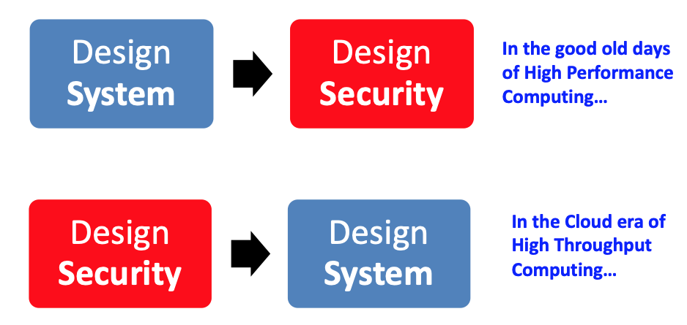
Modern Day System Security
6

Slide 7
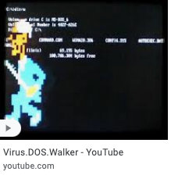
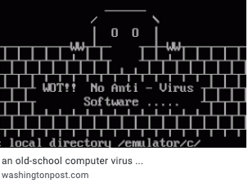
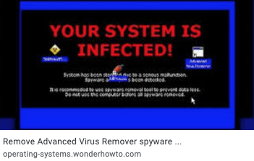
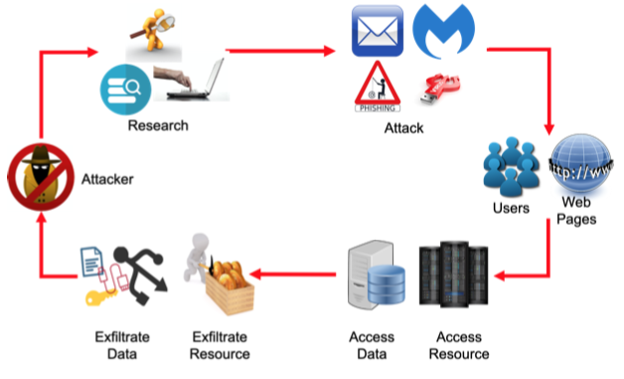
Virus Past and Modern
http://www.ted.com/talks/mikko_hypponen_fighting_viruses_defending_the_net#t-1021940
https://www.safetydetectives.com/blog/most-dangerous-new-malware-and-security-threats/
7

Slide 8
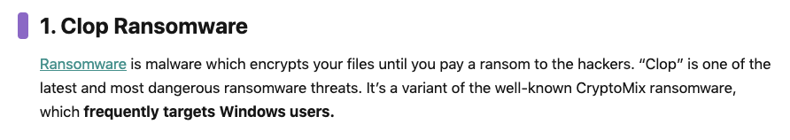
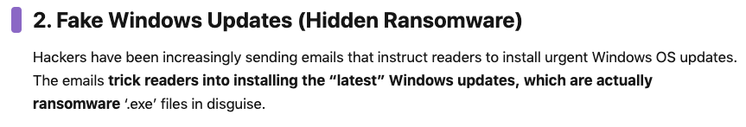
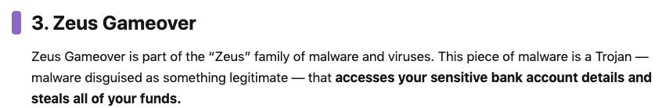
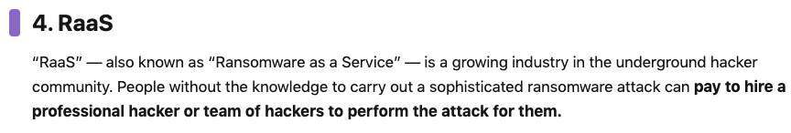
Modern Viruses
https://www.safetydetectives.com/blog/most-dangerous-new-malware-and-security-threats/
8

Slide 9
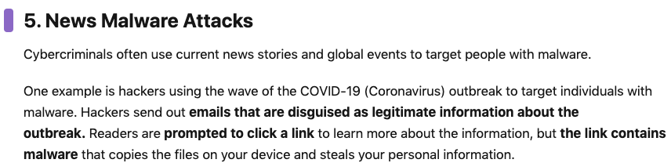
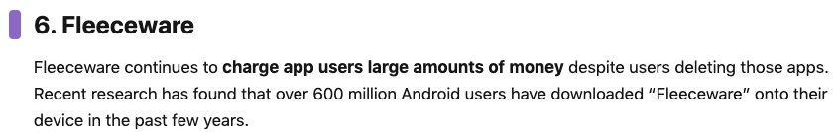
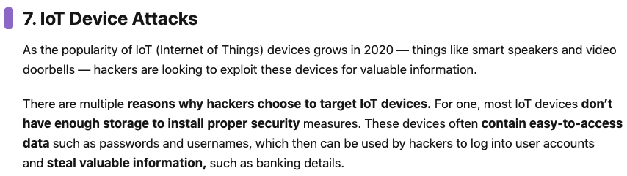



Modern Viruses
9

Slide 10
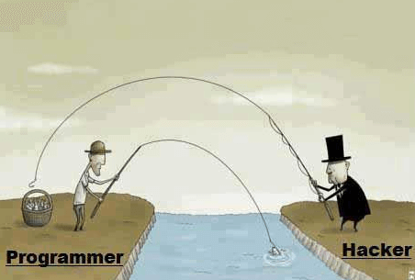
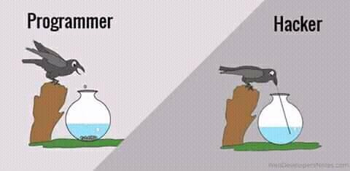
Hacking Humor Hackers find a way!
Minimum human supervision

Slide 11
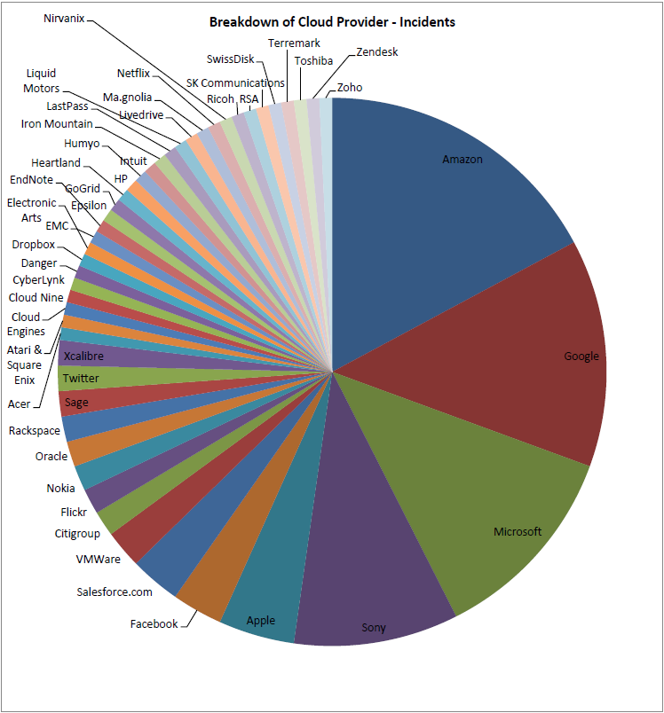
Everyone is being cyber-attacked!
You have been attacked, You are going to be attacked soon…

Slide 12

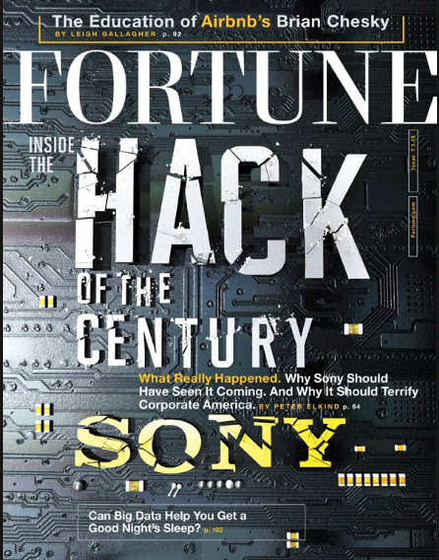
Sony Hack Story, 2014
https://en.wikipedia.org/wiki/Sony_Pictures_hack
https://deadline.com/2017/04/as-north-korea-rumbles-insiders-tell-how-small-players-stood-tall-helping-sonys-the-interview-1202069868/

Slide 13
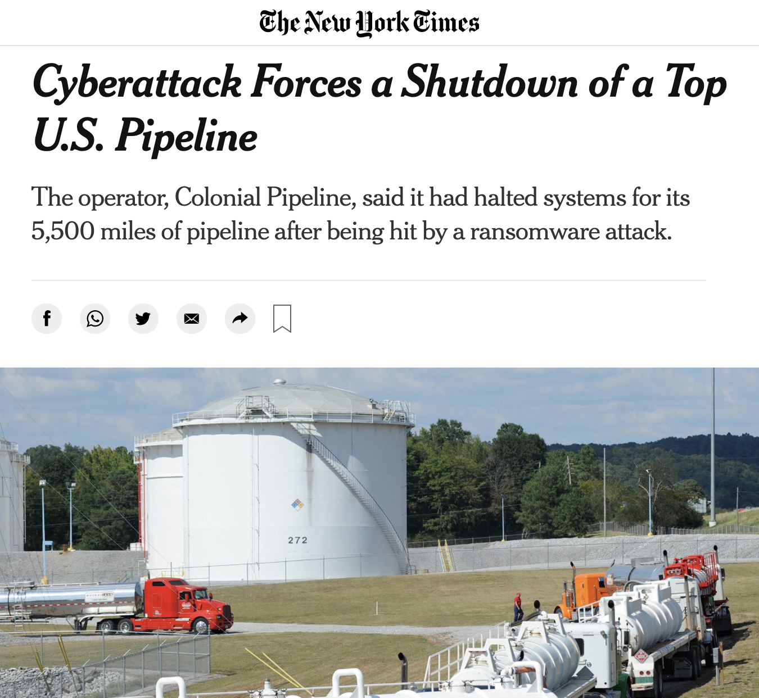
How does a serious intrusion today look like?
It’s a surprise!
(affects critical infrastructure)
It is disruptive!!
(All systems are taken down)
It has dire consequences!!!
(Gas prices climb)

Slide 14

Why Cyber-attacks are launched by hackers?
Entertainment
Disruptive mentality to write virus/worms/trojans
Social acceptance
Website defacement, “Hacker’s God”
Fraud
Hacking for SSN, Credit Card #s and other sensitive information
Earning ransoms
Threats to sabotage services using DDoS attacks
Cyber wars are the next threat to national security!
– Published in 2010
https://www.ted.com/talks/james_lyne_everyday_cybercrime_and_what_you_can_do_about_it#t-931371

Slide 15
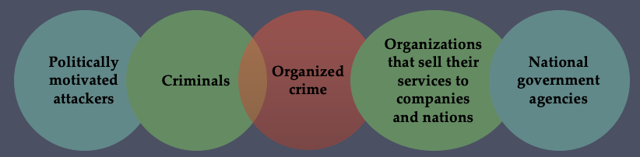
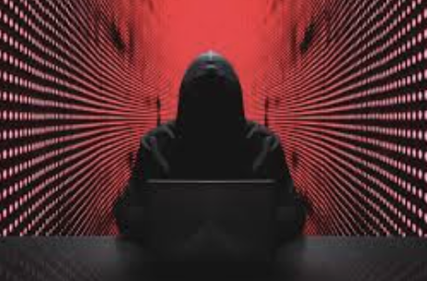
Cyber Attack Sources
Motivated hackers are highly organized and dangerous
They have significant resources available
Possess access to a large underground economy
Involving the sale of attack kits, access to compromised hosts, and to stolen information
15
Notes:
Another significant malware development over the last couple of decades is the
change from attackers being individuals, often motivated to demonstrate their
technical competence to their peers, to more organized and dangerous attack
sources. These include politically motivated attackers, criminals, and organized
crime; organizations that sell their services to companies and nations, and national
government agencies, as we discuss in Section 8.1. This has significantly changed the
resources available and motivation behind the rise of malware, and indeed has led
to development of a large underground economy involving the sale of attack kits,
access to compromised hosts, and to stolen information.

Slide 16
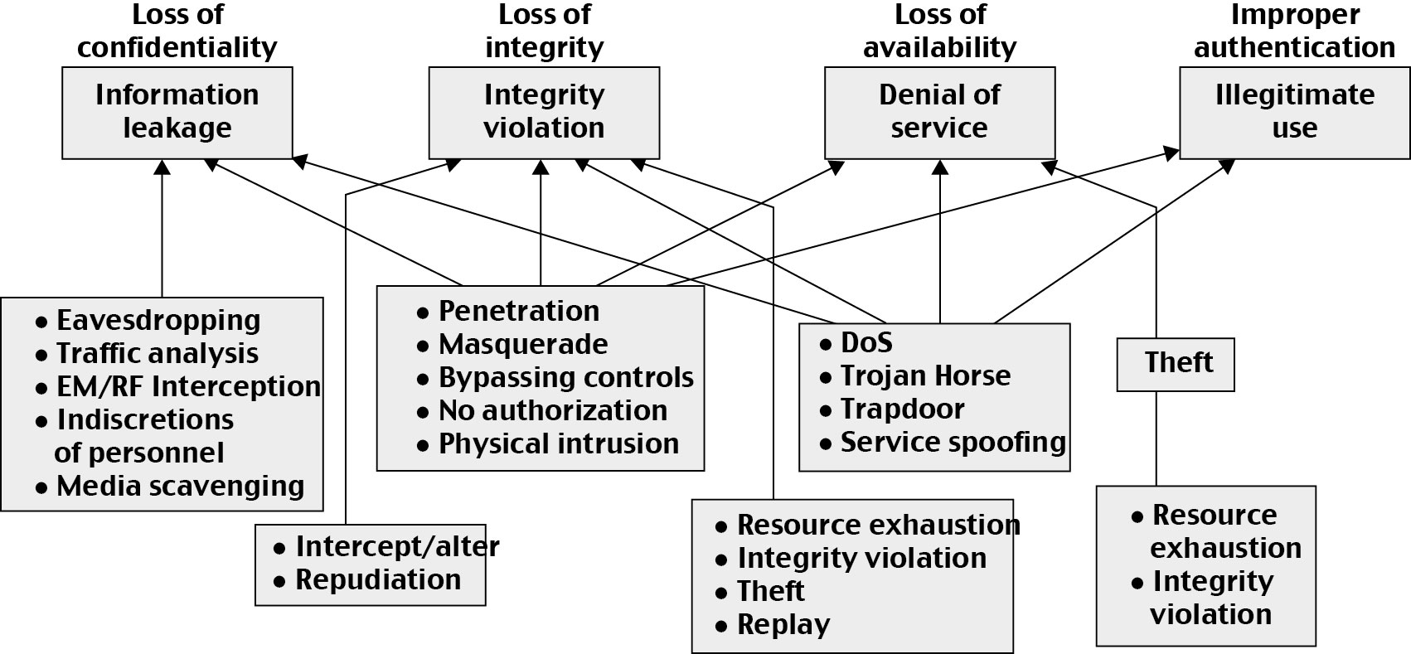
Types of Cyber Attacks

Slide 17
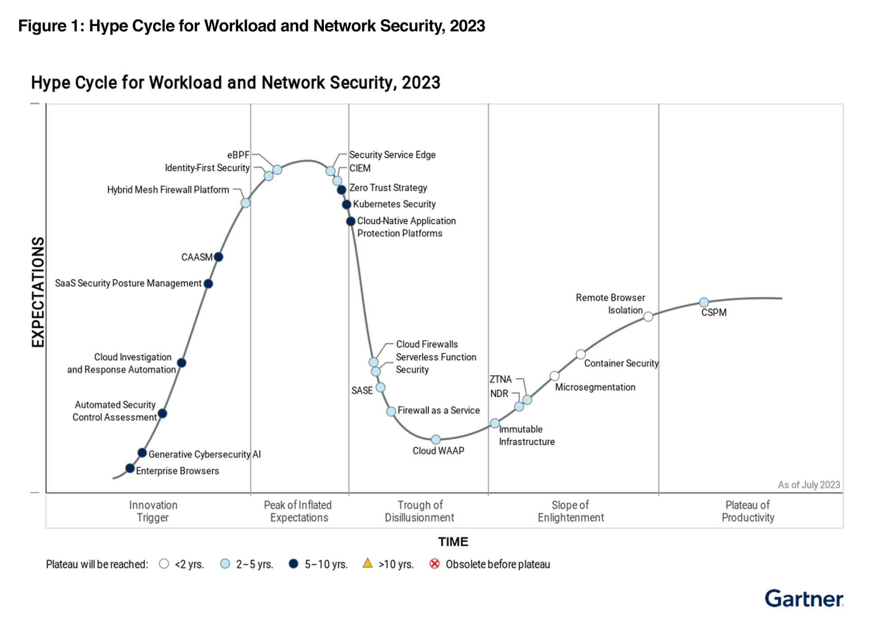
Gartner® Hype Cycle™ for Workload and Network Security, 2023

Slide 18
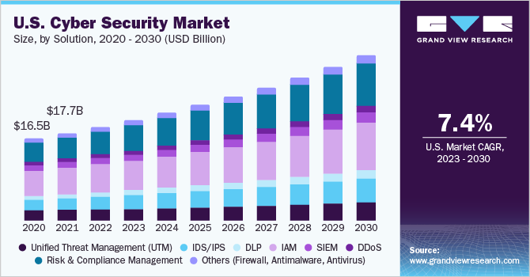
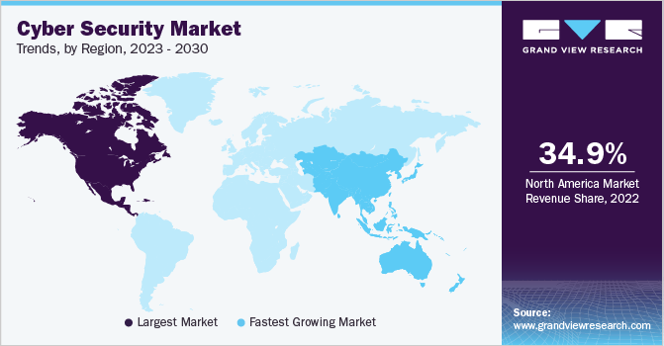
Growth of Cybersecurity Industry

Slide 19
Cyber Security Career Opportunities
Cybersecurity is a major hiring thrust in industry, government
Forbes: The global cyber security market size was estimated at USD 202.72 billion in 2022 and is projected to grow at a compound annual growth rate (CAGR) of 12.3% from 2023 to 2030.
Secretary of Commerce Wilbur Ross stated in 2018, “A skilled cybersecurity workforce is necessary for our nation so that we can fully reap the benefits of the 21st-century digital economy.”
Number of jobs for fresh graduates is expected to grow over the next 8-10 years, with a predicted employment trend of 10.24%, an average rate of growth (total labor market 5.78%)
The average salary in the nation for fresh graduates is $103,774
Cybersecurity spans research and economy
Attractive component of curriculum for students planning to “graduate and work in industry” or “go on to PhD”

Slide 20
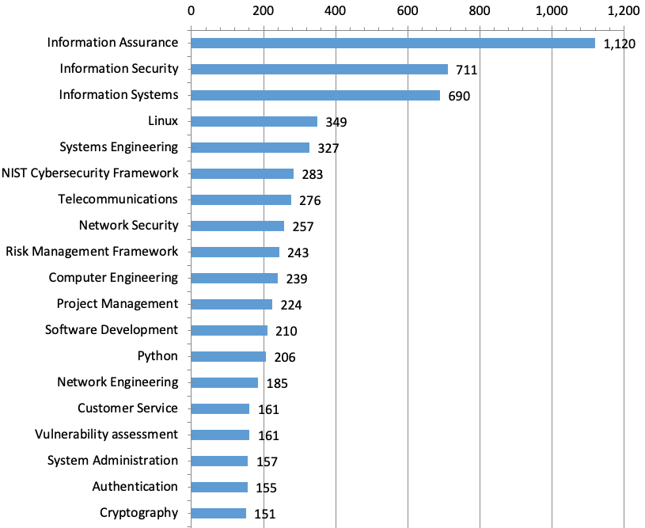
Skills in Greatest Demand (Employer job posting results)
According to CyberSeek (https://www.cyberseek.org/), there were an estimated 504,316 active openings for cybersecurity jobs in the US as of April 26, 2020

Slide 21
Sample Cybersecurity Engineer Job Description
Job Title: Cybersecurity Engineer
Cybersecurity engineers are the gatekeepers of information within an organization, responsible for the protection and security of the systems that store this data
They are in charge of the network and systems in a security capacity; they execute and plan security measures accordingly
Cybersecurity engineers help to keep attackers at bay by implementing safeguards that prevent intrusions and breaches
Cybersecurity engineers don’t work in isolation, though, and they are widely seen as being an extension of the IT department
https://resources.infosecinstitute.com/category/cybersecurity-careers/how-to-become-a-cybersecurity-engineer/cybersecurity-engineer-job-description/#gref

Slide 22
Course Summary

Slide 23
This is a COIL Program Course!
Collaborative Online International Learning (COIL) Program with Lucerne University of Applied Sciences and Arts (HSLU), Switzerland on the Data Science Basics Course, given by Dr. Luca Mazzola (luca.mazzola@hslu.ch)
What is COIL? https://www.youtube.com/watch?v=ix8CoP9pzQI
One (or Two) Project Group will join in this COIL program. You will have meetings with HSLU students and do the following objectives:
Shared Datasets: Collaborate on creating datasets that encompass cybersecurity challenges prevalent in different regions. This can facilitate joint analysis and understanding of diverse threat landscapes.
Joint Analysis and Modeling: Encourage joint analysis of datasets focusing on international cybersecurity incidents. Merge skills from both classes to model and predict global cybersecurity trends or threats.
Ethical Considerations: Discuss the ethical implications of data science techniques in the context of global cybersecurity and data privacy laws in different countries.

Slide 24
So, this course in short is…
A fun course on Computer Security covering: application and network security foundations, advanced concept labs, in-class discussion of state-of-the-art research, and a half-semester-length project implementation/report/talk!!! ☺
Notes:
* Cyberdefense Magazine
* https://youtu.be/J_W9IhA2UeU (NICE)
* https://minerva-labs.com/minerva-anti-evasion-platform
* U of Arkansas Platoon Cyber Range - https://www.mengjunxie.org/papers/SIGITE_2016.pdf / https://www.mengjunxie.org/cyberdefense/
https://cisa.umbc.edu/files/2019/05/CATS-2017-Cyber-Summit-arxiv.pdf [https://cisa.umbc.edu/cats/documents/ https://cisa.umbc.edu/files/2017/05/summary-CATs-9-29-14.pdf]
https://www.scmagazine.com/home/opinion/executive-insight/train-your-soc-team-now/
https://www.mengjunxie.org/cyberdefense/

